Slide 1

CENTRAL UNIVERSITY OF RAJASTHAN
DEPARTMENT OF COMPUTER SCIENCE
MINI PROJECT (CSC-504)
Breast Cancer Detection Using Deep Learning & IOT Technologies
SUBMITTED BY: SUPERVISED BY:
GANESH SAINI Dr. NISHTHA KESSWANI
M.Sc. CS (AI) (SEM-III) (ASSISTANT PROFESSOR)
2021MSCS004

Slide 2

Breast Cancer Detection Using Deep learning & IoT Technologies

Slide 3
Table of contents
Breast Cancer
CNN and Thermal Imaging(IR)
Hardware Implementation of the project
Convolutional Neural Network (CNN)
Confusion matrix
Model Accuracy and Loss Graph
GUI Result
Result And Conclusion
References

Slide 4
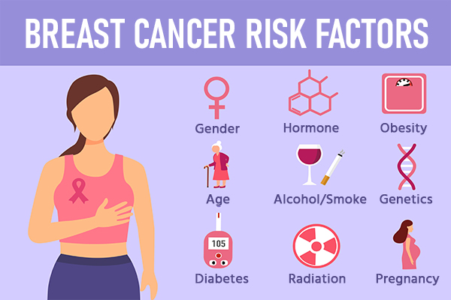
Breast cancer
Breast cancer is cancer that forms in the cells of the breasts. After skin cancer, breast cancer is the most common cancer diagnosed in women in the world. Breast cancer can occur in both men and women, but it's far more common in women[2].
According to a study by the Indian Council of Medical Research, the number of new cases of breast cancer is expected to reach 1,94,000 in India by the year 2022. There are an estimated 2.8 million women living with breast cancer in India. Although breast cancer rates are lower in India than in many Western countries, the number of cases is increasing[3].
Risk factors for breast cancer in India include:
-Increasing age
-Family history of breast cancer
-Obesity & Diet high in saturated fat
-Nulliparity (never having given birth)
-Late age at first birth

Slide 5
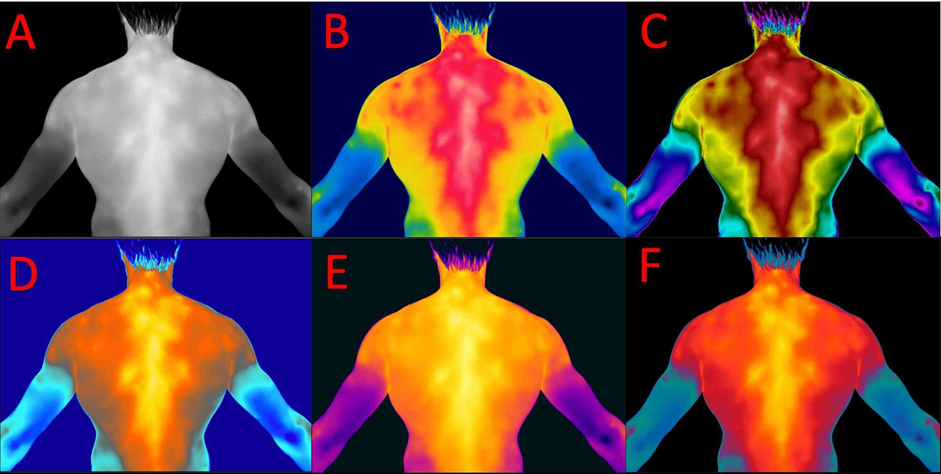
Cnn and thermal imaging
Convolutional Neural Networks (CNN) have proven to be an efficient method in detecting and diagnosing patients' health by performing image processing on previously generated data.[1]
Thermal Imaging is an upcoming technology that uses infrared sensors to determine the heat of a region and create images known as thermography technology. These images can help develop a picture of cancer cells and tumors in the cancer cell, allowing for improved diagnosis and treatment. Combining CNN with thermal imaging can provide more accurate and efficient methods of detecting and diagnosing health issues, leading to better patient outcomes.[1]

Slide 6
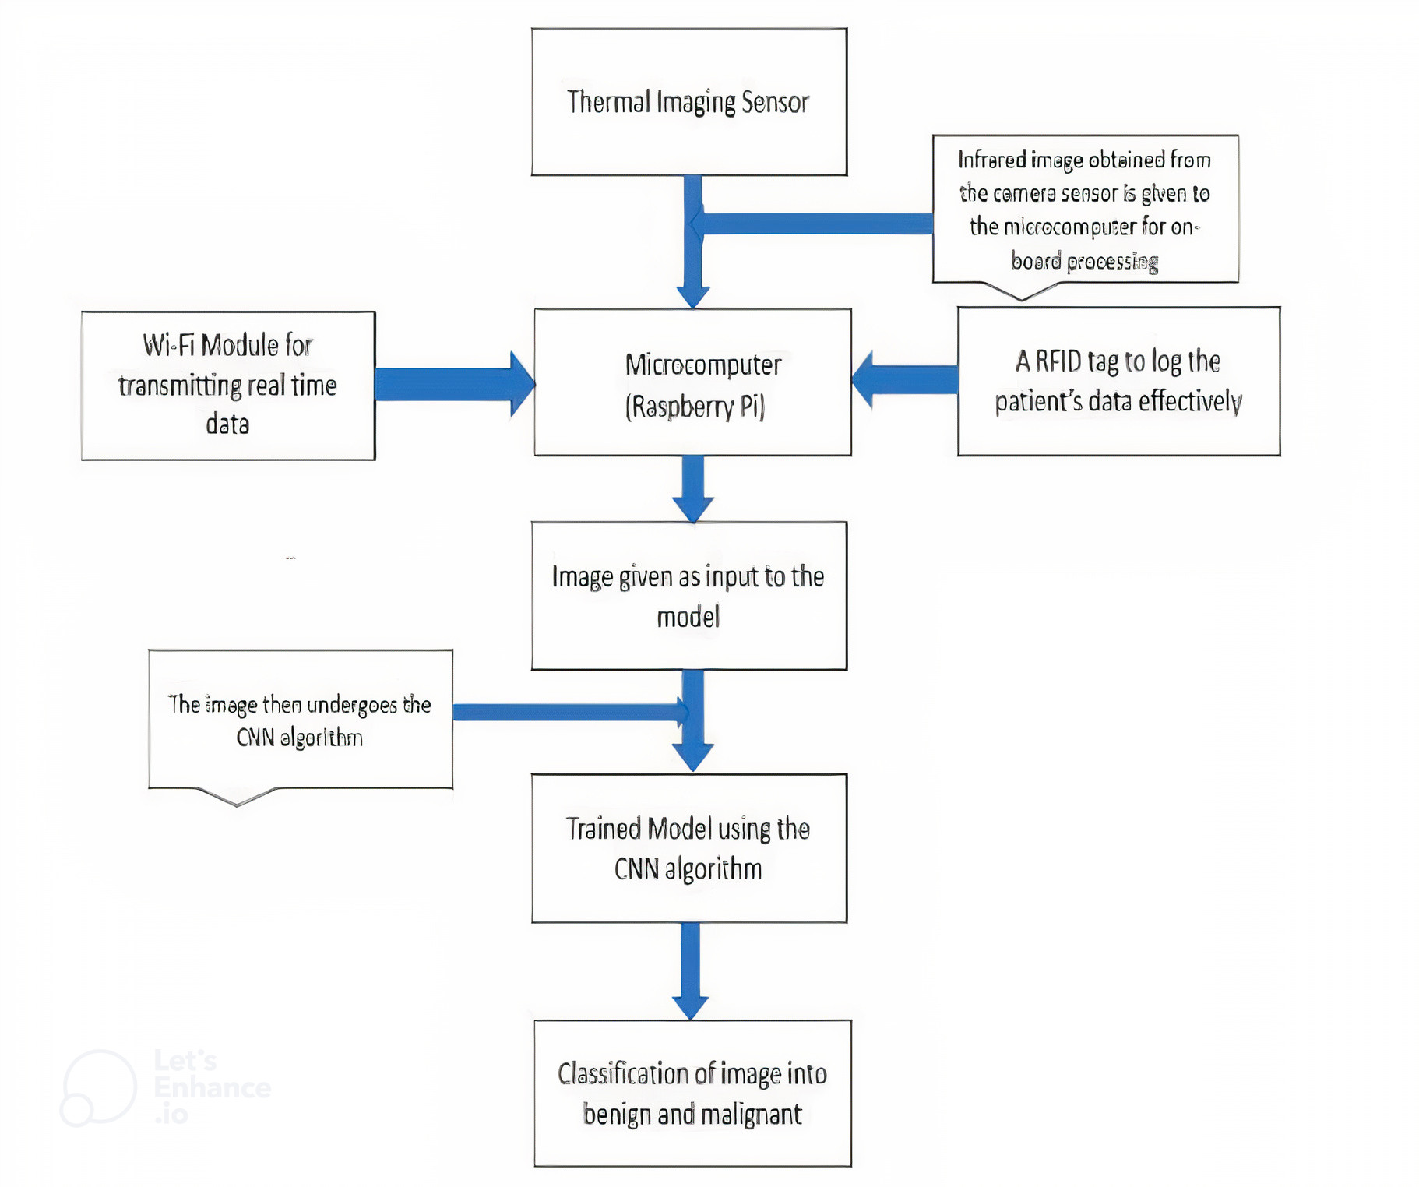
Hardware Implementation of the project[1]
1.Thermal Camera sensor: A thermal camera which makes use of the thermographic method helps to capture the image using the infrared rays reflected by the object. It works like a camera that captures images using visible light. Using the images captured by the thermal camera cancer cells can be detected.
2.Microcomputer (Raspberry PI): A microcomputer is used to integrate the thermal camera and perform onboard image processing to determine the presence of cancer in the patient.
3.Wi-Fi module: A Wi-Fi module is used to send real-time images to the doctor to examine the cancer cells via the cloud. Using this method, the doctor can easily treat the patient by analyzing the patient’s case beforehand.
4.RFID Reader: A RFID reader is connected to the microcomputer to keep the patient’s data secure and for easy and efficient logging of the data. This also helps keep track of different users.

Slide 7
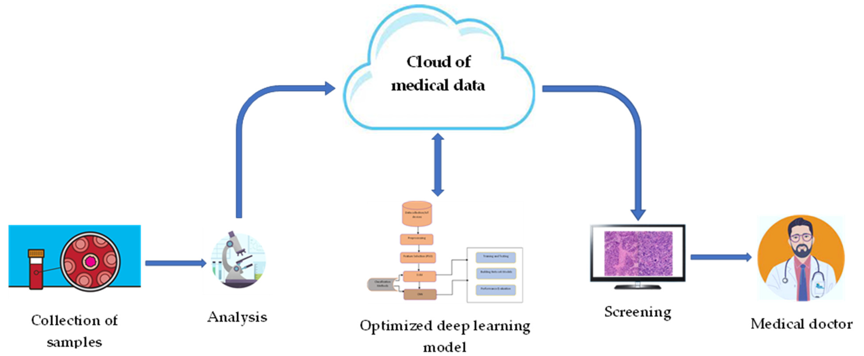
Figure 1. Schematic architectural diagram of the proposed medical IoT-based breast cancer diagnosis framework for automatic identification of breast cancer using the proposed hyperparameter optimized CNN classifier.
Reference link : https://www.mdpi.com/1999-5903/14/5/153

Slide 8
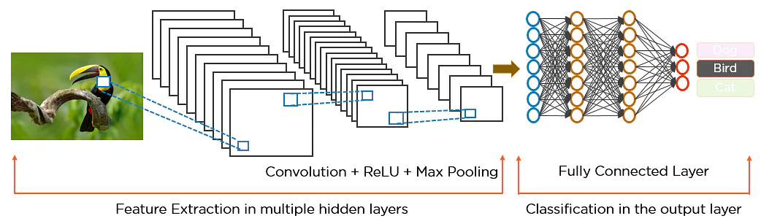
Convolution neural network (cnn)
Convolutional Neural Networks (CNNs) are a type of neural network that is commonly used for image and video analysis tasks. It’s also known as a ConvNet. A convolutional neural network is used to detect and classify objects in an image[4].

Slide 9
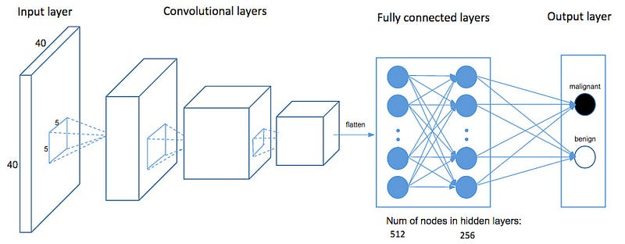

How CNN recognizes a image (malignant and benign)
The pixels from the image are fed to the convolutional layer that performs the convolution operation
It results in a convolved map
The convolved map is applied to a ReLU function to generate a rectified feature map
The image is processed with multiple convolutions and ReLU layers for locating the features
Different pooling layers with various filters are used to identify specific parts of the image
The pooled feature map is flattened and fed to a fully connected layer to get the final output

Slide 10
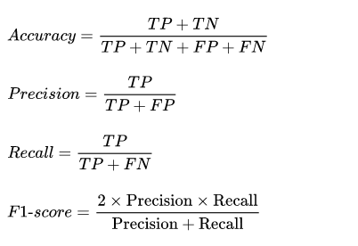
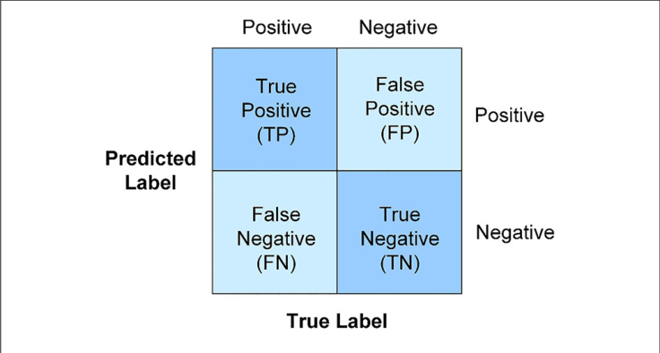
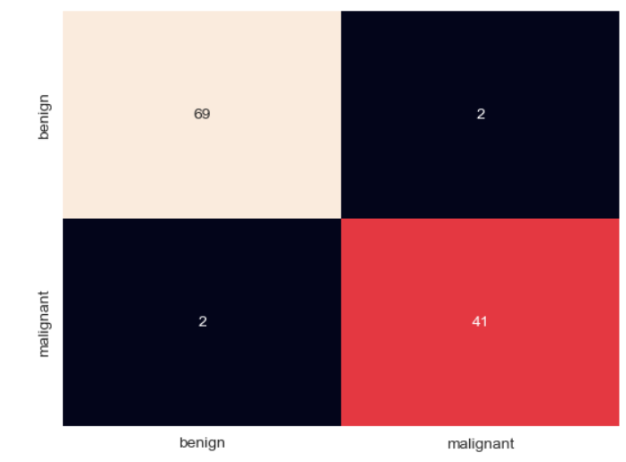
Confusion matrix
A Confusion Matrix is a table that is used to evaluate the performance of a classification model. It shows the number of correct and incorrect predictions made by the model on a set of test data, compared to the actual outcomes.
True positive (TP): This means a person is corrected predicted a positive outcome classified as breast cancer.
True Negative (TN): This means a person is corrected predicted a negative outcome.
False Positive (FP):This means a person is incorrected predicted a positive outcome.
False Negative (FN):):This means a person is incorrected predicted a negative outcome.
Reference link : https://www.mdpi.com/1999-5903/14/5/153

Slide 11
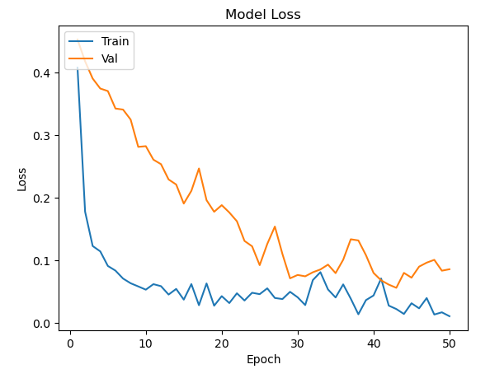
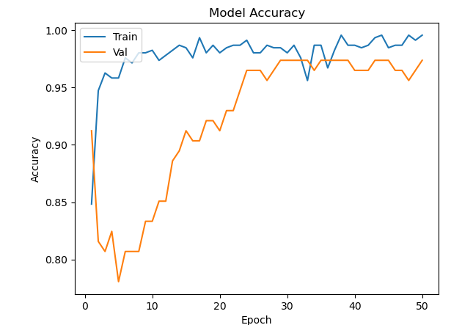
MODEL ACCURACY AND LOSS graph
If validation accuracy is greater than Training accuracy it means the model isn't overfitting
unless and until validation loss goes above the Training loss we can keep on Training our model

Slide 12
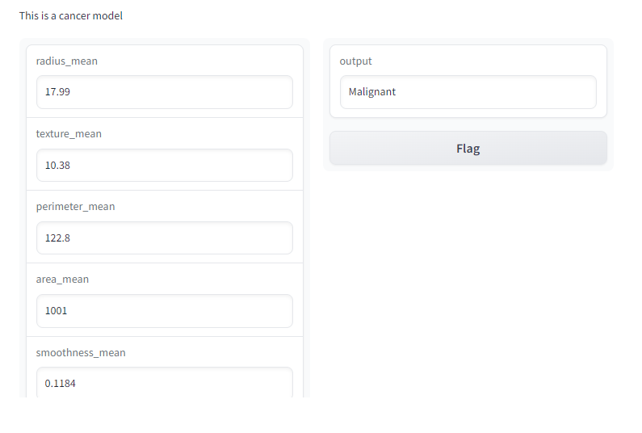
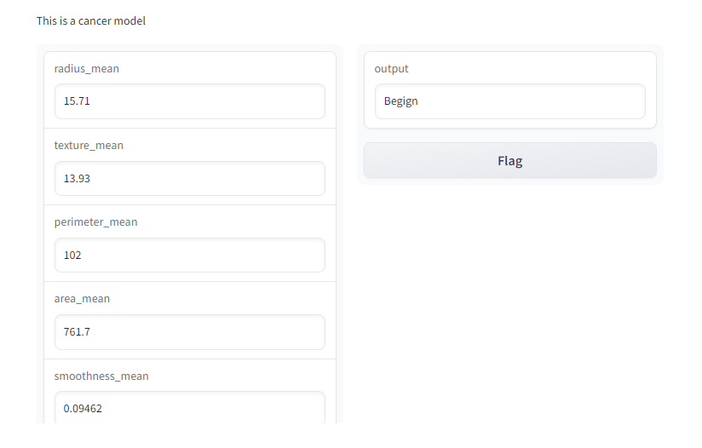
GUI result

Slide 13
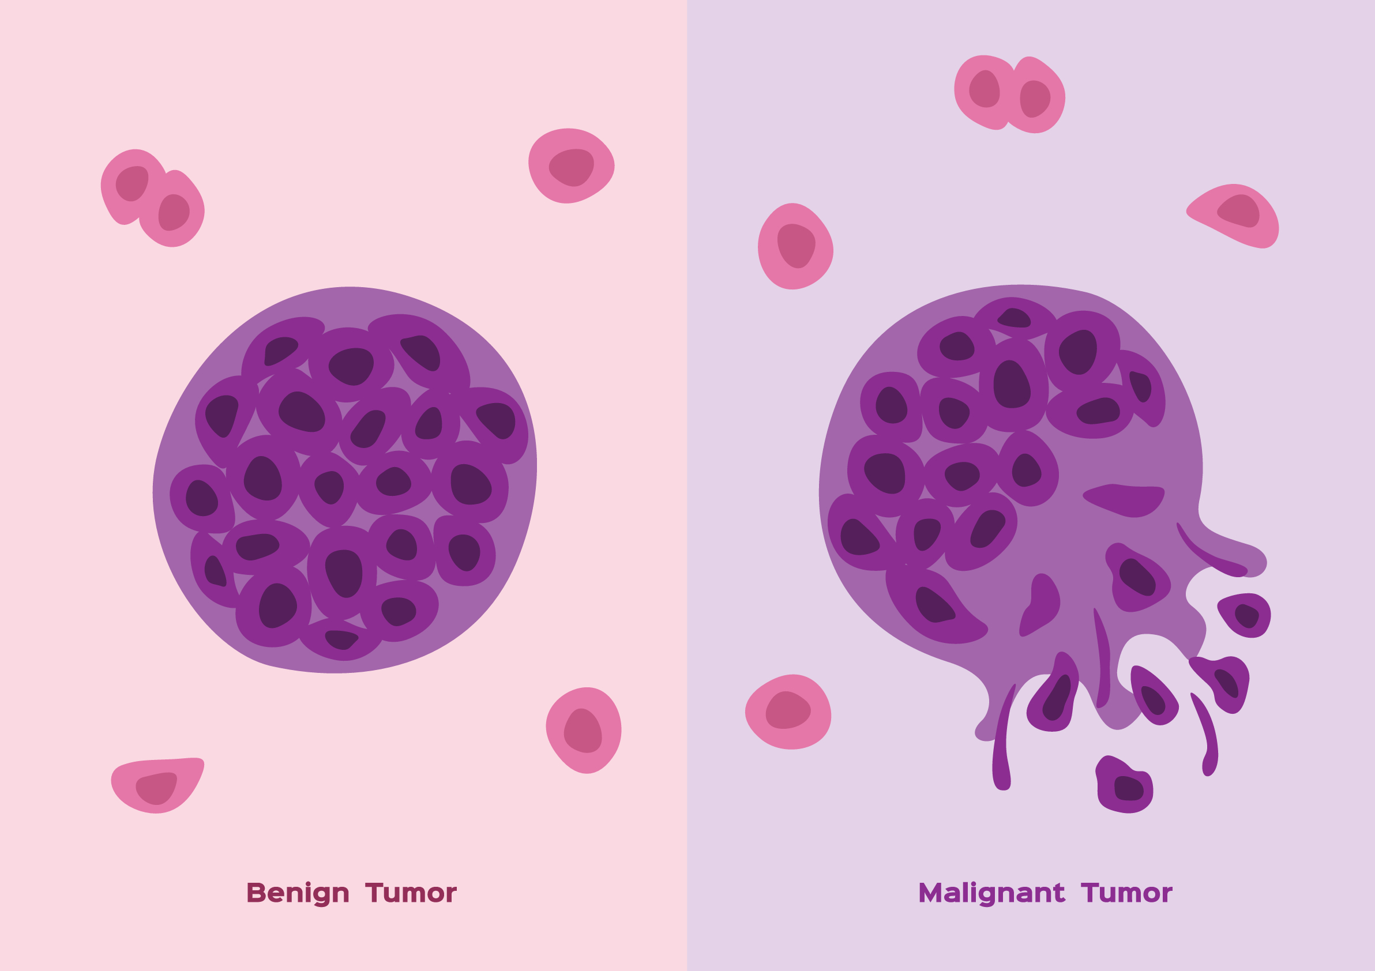

result and conclusion
The CNN algorithm provides an accuracy of about 97.3% on the validation dataset.
In the future, our research aims to expand by using larger datasets with deep learning techniques and optimization methods to improve our ability to identify breast cancer. Overall, our model is effective in detecting both benign and malignant breast cancer cases.[1]

Slide 14
references
1. Salvi, Siddhant, and Ameya Kadam. "Breast Cancer Detection Using Deep learning and IoT Technologies." Journal of Physics: Conference Series. Vol.1831. No. IOP Publishing, (2021).
2.Ogundokun, Roseline Oluwaseun, et al. "Medical internet-of-things based breast cancer diagnosis using hyperparameter-optimized neural networks." Future Internet 14.5 (2022): 153.
Breast Cancer Wisconsin (Diagnostic) Data Set Kaggle, available at
https://www.kaggle.com/datasets/uciml/breast-cancer-wisconsin-data
3. Breast Cancer
https://www.mayoclinic.org/diseases-conditions/breast-cancer/symptoms-causes/syc-20352470
4. Breast Cancer studies and Risk factor
https://main.icmr.nic.in/guidelines?field_select_disease_tid=91
5. Convolution Neural Network (CNN) & layers
https://www.simplilearn.com/tutorials/deep-learning-tutorial/convolutional-neural-network
6. https://en.wikipedia.org/wiki/Breast_cancer

Slide 15
Thank You

